Slide 1

Lesson 12 - CSS Layout - Part I
Dhananjay Mandalkar
ReDi School, NRW

Slide 2
1. Normal Flow
Normal document flow in CSS is the default way in which HTML elements are arranged and displayed on a web page without any positioning, floating, or flexbox/grid properties applied. The positioning of elements is determined by their display property and their placement in the HTML document.
In this flow, HTML elements are positioned according to their order in the HTML document, from top to bottom and left to right.
index1.html

Slide 3

Block-level elements:
Block elements, like <div>, <p>, and <h1>, automatically take up the full width of their container and stack vertically on top of one another.
index2.html

Slide 4
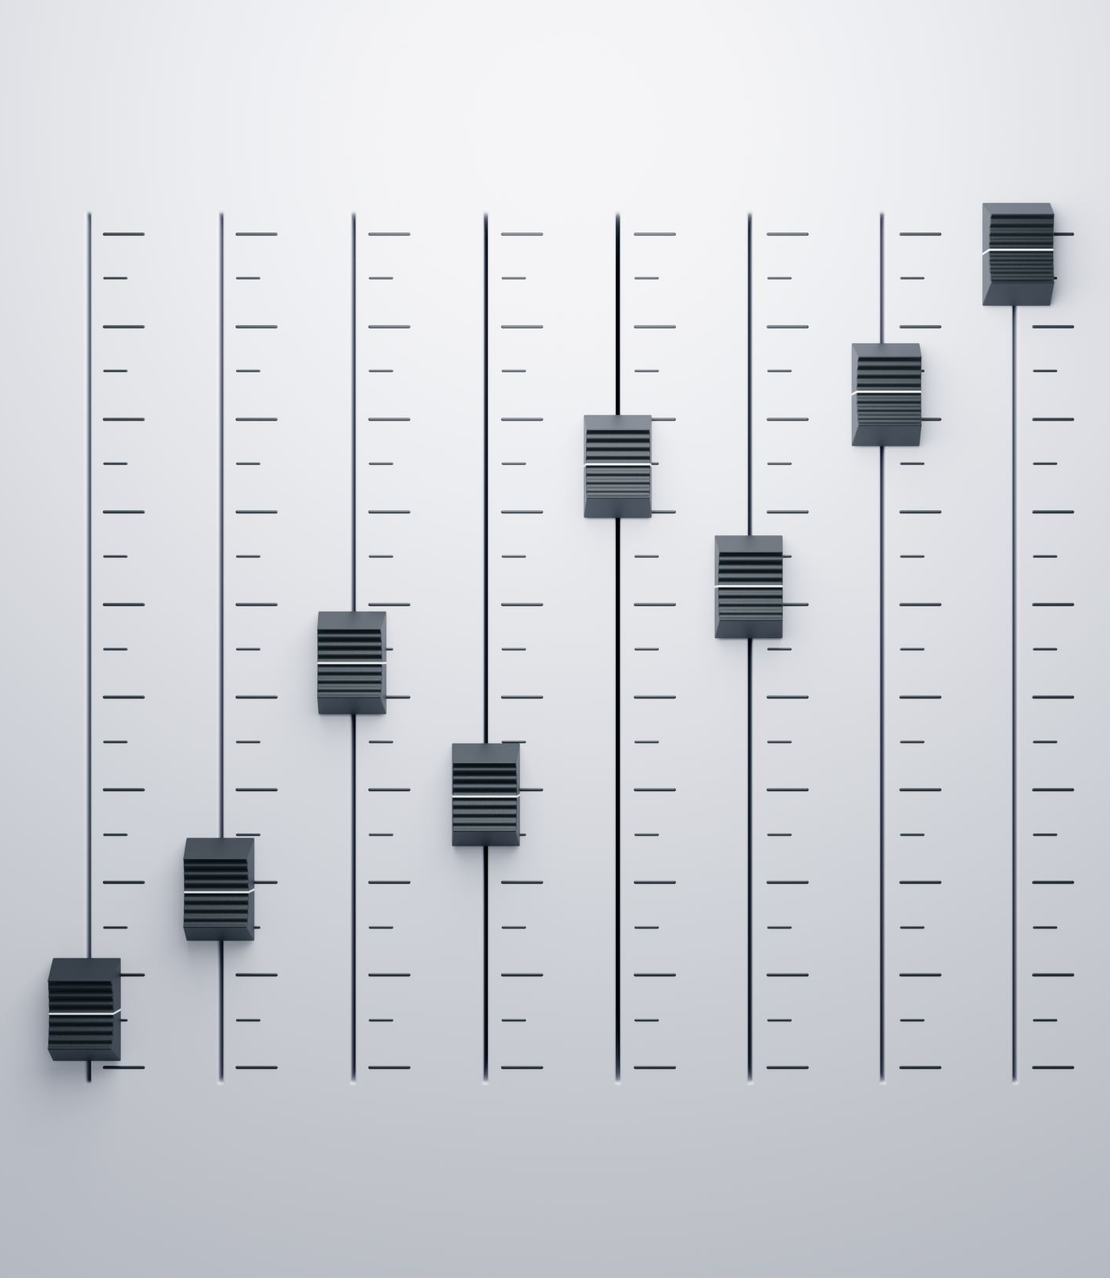
Inline Elements Definition
Inline elements are HTML elements that are displayed inline with the surrounding text. This means that they don't start on a new line and only take up as much width as necessary to display their content.
Examples of inline elements include <span>, <a>, <strong>, and <em>.
index3.html

Slide 5
Inline Elements Default display
By default, most HTML elements are displayed as either block-level or inline-level elements. However, some elements have a default display of inline, such as <span>, <a>, <strong>, and <em>.
This means that they are already set to display inline and do not require any additional CSS to do so.
index3.html

Slide 6
Inline Elements
Box model
Even though inline elements are displayed inline with text, they still follow the CSS box model.
This means that they have properties such as padding, border, and margin, which affect their size and position.
However, their height and width properties do not have any effect on the element's size.
index4.html

Slide 7
Normal Flow
display: inline-block
width: This property sets the width of the inline-block element. Unlike inline elements, which take up only as much width as necessary, inline-block elements can have a specified width.
This allows them to be positioned and aligned with greater precision.
height: This property sets the height of the inline-block element. Like the width property, it allows the element to have a specific height, which is not possible with pure inline elements.
padding: This property sets the amount of padding space around the content of the inline-block element. Padding is the space between the content and the border of the element.
Using padding with inline-block elements can help to create a consistent and visually appealing layout.
index7.html
https://css-tricks.com/when-do-you-use-inline-block/

Slide 8
Inline Elements
Text formatting
Inline elements are commonly used for text formatting, such as bolding or italicizing text.
For example, the <strong> element is used to make text bold, and the <em> element is used to italicize text.
These elements can be styled with CSS to change the font family, size, color, and other text properties.

Slide 9

Inline Elements Nesting
Inline elements can be nested inside other inline elements, but they cannot contain block-level elements.
This means that if you want to add a block-level element inside an inline element, you need to change the display property of the parent element to "block" or "inline-block".
Without the display: inline-block property, the a element would remain inline-level, and the div element would be considered an invalid child element of a. As a result, the browser would attempt to fix the HTML structure by moving the div element outside of the a element, resulting in unexpected layout and possibly broken functionality.
index5.html and index6.html

Slide 10
2. The display Property
You can change how elements behave in normal flow with the display property.
Exercise:
Apply a border on all elements on your page.
Using the dev tools, identify elements with display block and change them to inline (and vice versa)
Observe how the flow of elements on the page changes

Slide 11

3. Floats
The "float" CSS property lets you put an element on the left or right side of its container. This makes text and other elements wrap around it. The element will no longer be in its normal position on the page, but it will still be a part of the page's layout (unlike if you used "absolute positioning").
https://developer.mozilla.org/en-US/docs/Web/CSS/float
https://css-tricks.com/all-about-floats/
float: left
float: right
index8.html and index9.html

Slide 12

Clearing floats
Clearing floats is a CSS technique for preventing floating components from influencing elements outside their container. The "clearfix" approach is the most commonly used way for clearing floats.
index10.html
homework1.html
homework2.html

